Slide 1
Chapter 9
Using Telephone and Cable Networks for Data Transmission
長庚大學資訊工程學系 陳仁暉 教授
Tel: (03) 211-8800 ext: 5990
Email: jhchen@mail.cgu.edu.tw
URL: http://www.csie.cgu.edu.tw/~jhchen

Slide 2
9-1 TELEPHONE NETWORK
Telephone networks use circuit switching. The telephone network had its beginnings in the late 1800s. The entire network, which is referred to as the plain old telephone system (POTS), was originally an analog system using analog signals to transmit voice.
Topics discussed in this section:
Major Components
LATAs
Signaling
Services Provided by Telephone Networks
NDSLab Copyright@2008

Slide 3
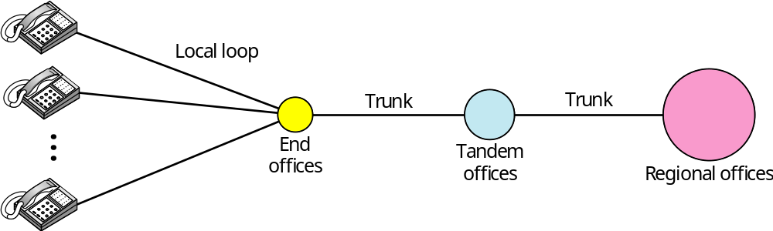
Figure 9.1 A telephone system
NDSLab Copyright@2008

Slide 4
Telephone System
Local loops
  A twisted-pair cable that connects the subscriber telephone to the nearest end office or local central office.
  The local loop, when used for voice, has a bandwidth of 4000 Hz (4 kHz).
Trunks
  A transmission media that handle the communication between offices.
  Handles hundreds or thousands of connections through multiplexing.
Switching office
  Connects several local loops or trunks
NDSLab Copyright@2008

Slide 5
Local-Access Transport Areas
LATAs (local-access transport areas)
  In January 1, 1984, AT&T was broken into AT&T Long Lines, 23 Bell Operating Companies (BOCs)
Intra-LATA services
  Common carriers
  local exchange carrier (LEC)
    Incumbent local exchange carrier (ILEC)
      Provided services before 1996 owns the cabling system (local loops)
    Competitive local exchange carriers (CLEC)
      New carriers that can provide services
Inter-LATA services
  Interexchange carriers (IXCs)
    Long-distance companies
NDSLab Copyright@2008

Slide 6

Note
Intra-LATA services are provided by local exchange carriers.
Since 1996, there are two
types of LECs: incumbent local exchange carriers and competitive
local exchange carriers.
NDSLab Copyright@2008

Slide 7
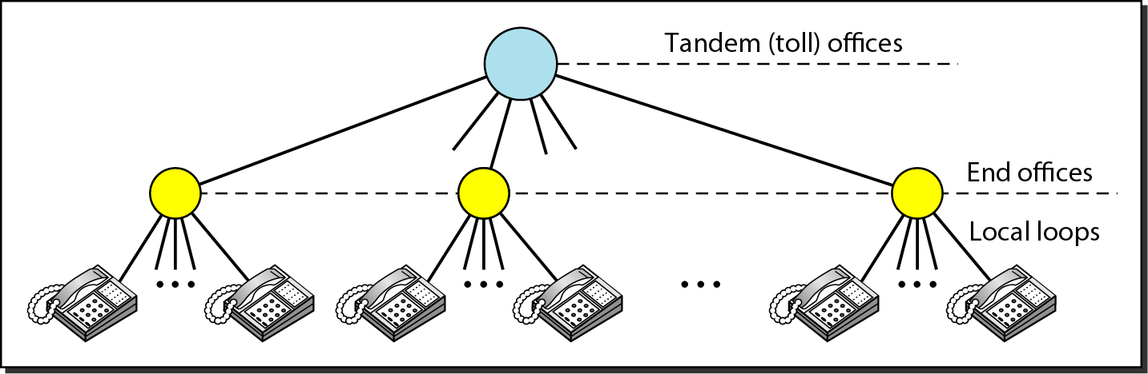
Figure 9.2 Switching offices in a LATA
NDSLab Copyright@2008

Slide 8
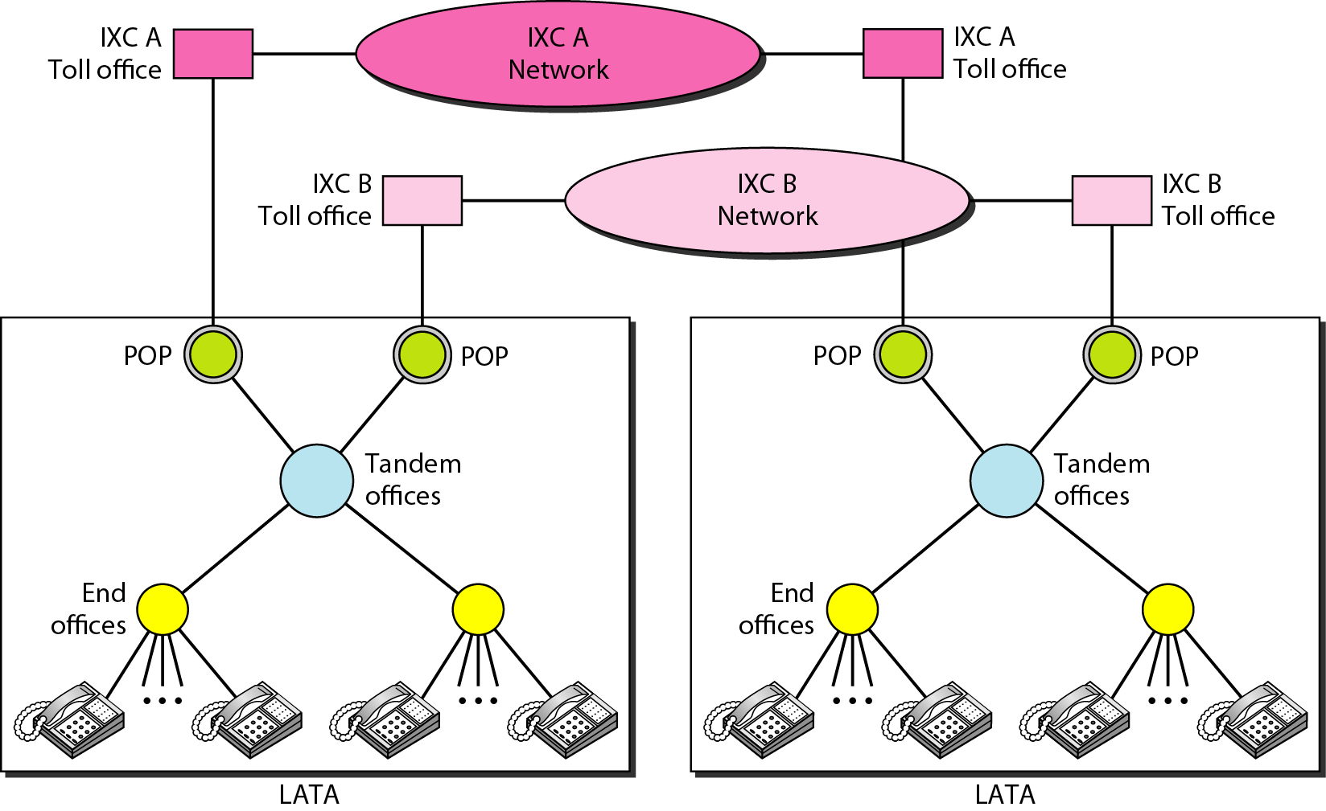
Figure 9.3 Point of presences (POPs)
NDSLab Copyright@2008

Slide 9
Signaling
In-band signaling
  The communication (setup and teardown phases) is performed by human operators and finished in the same circuit for both signaling and voice communication.
Out-band signaling
  Use the digital signals to create a connection between the caller and the called parties.
  A portion of the voice channel bandwidth is used for signaling.
NDSLab Copyright@2008

Slide 10
Signaling Systems Today
Signaling system’s tasks nowadays
  Providing dial tone, ring tone, and busy tone
  Transferring telephone numbers between offices
  Maintaining and monitoring the call
  Keeping billing information
  Maintaining and monitoring the status of the telephone network equipment
  Providing other functions such as caller ID, voice mail, and so on
NDSLab Copyright@2008

Slide 11
Note
The tasks of data transfer and signaling are separated in modern telephone networks: data transfer is done by one network, signaling by another.
NDSLab Copyright@2008

Slide 12
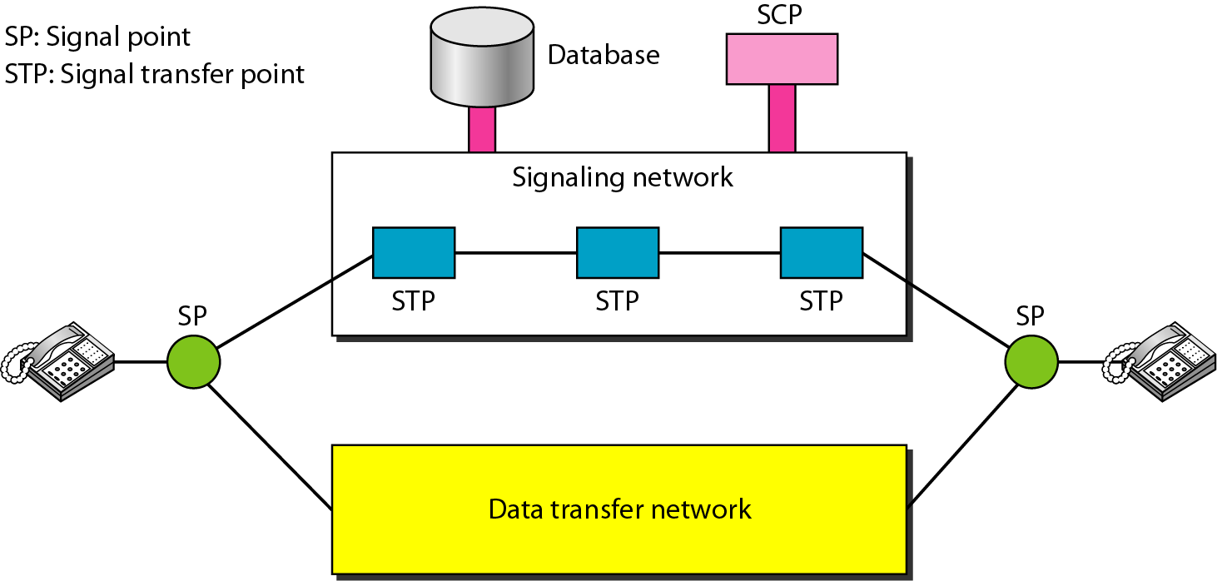
Figure 9.4 Data transfer and signaling networks
SCP: service control point
NDSLab Copyright@2008

Slide 13
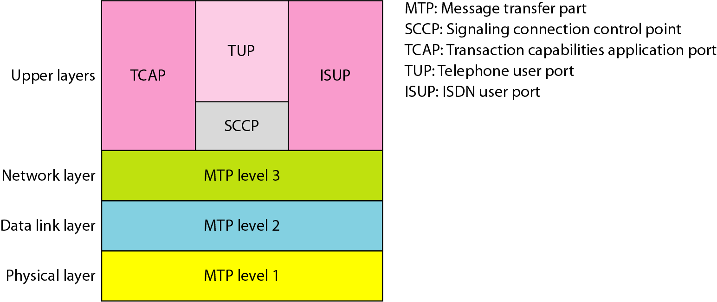
Figure 9.5 Layers in SS7
NDSLab Copyright@2008

Slide 14
9-2 DIAL-UP MODEMS
Traditional telephone lines can carry frequencies between 300 and 3300 Hz, giving them a bandwidth of 3000 Hz. All this range is used for transmitting voice, where a great deal of interference and distortion can be accepted without loss of intelligibility.
Topics discussed in this section:
Modem Standards
NDSLab Copyright@2008

Slide 15
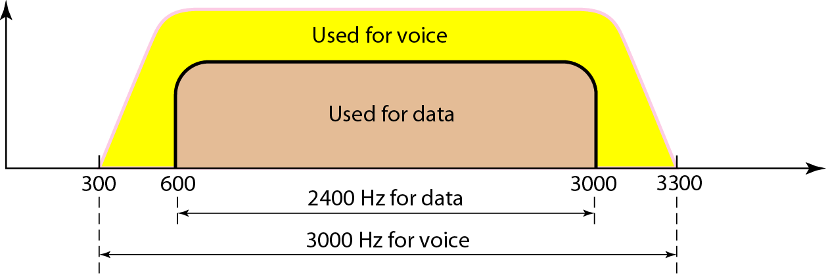
Figure 9.6 Telephone line bandwidth
NDSLab Copyright@2008

Slide 16
Note
Modem
stands for modulator/demodulator.
NDSLab Copyright@2008

Slide 17
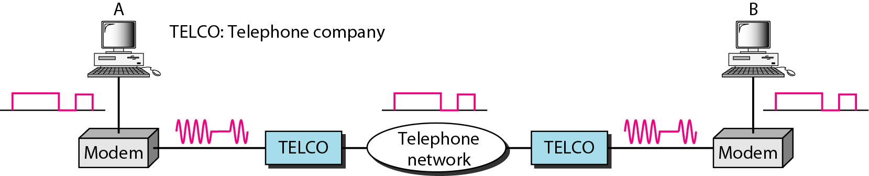
Figure 9.7 Modulation/demodulation
NDSLab Copyright@2008

Slide 18
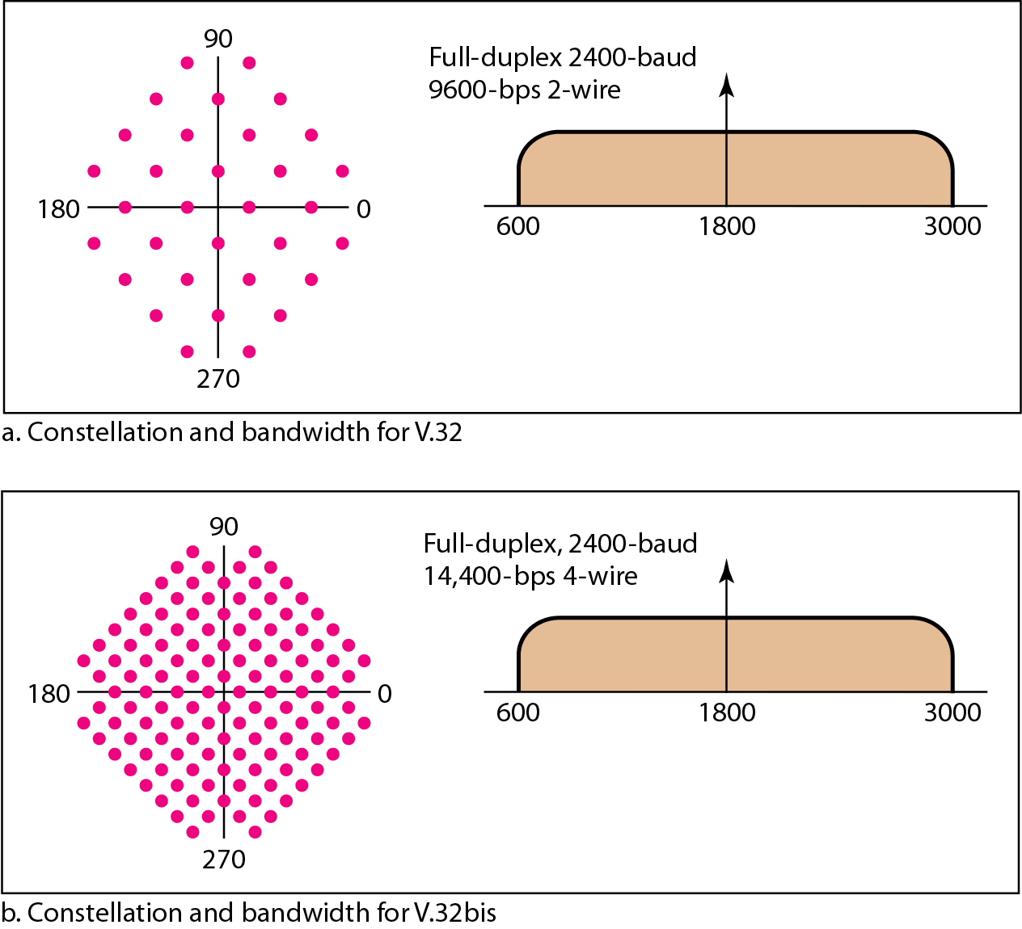
Figure 9.8 The V.32 and V.32bis constellation and bandwidth
32-QAM
128-QAM
7bits/baud
NDSLab Copyright@2008

Slide 19
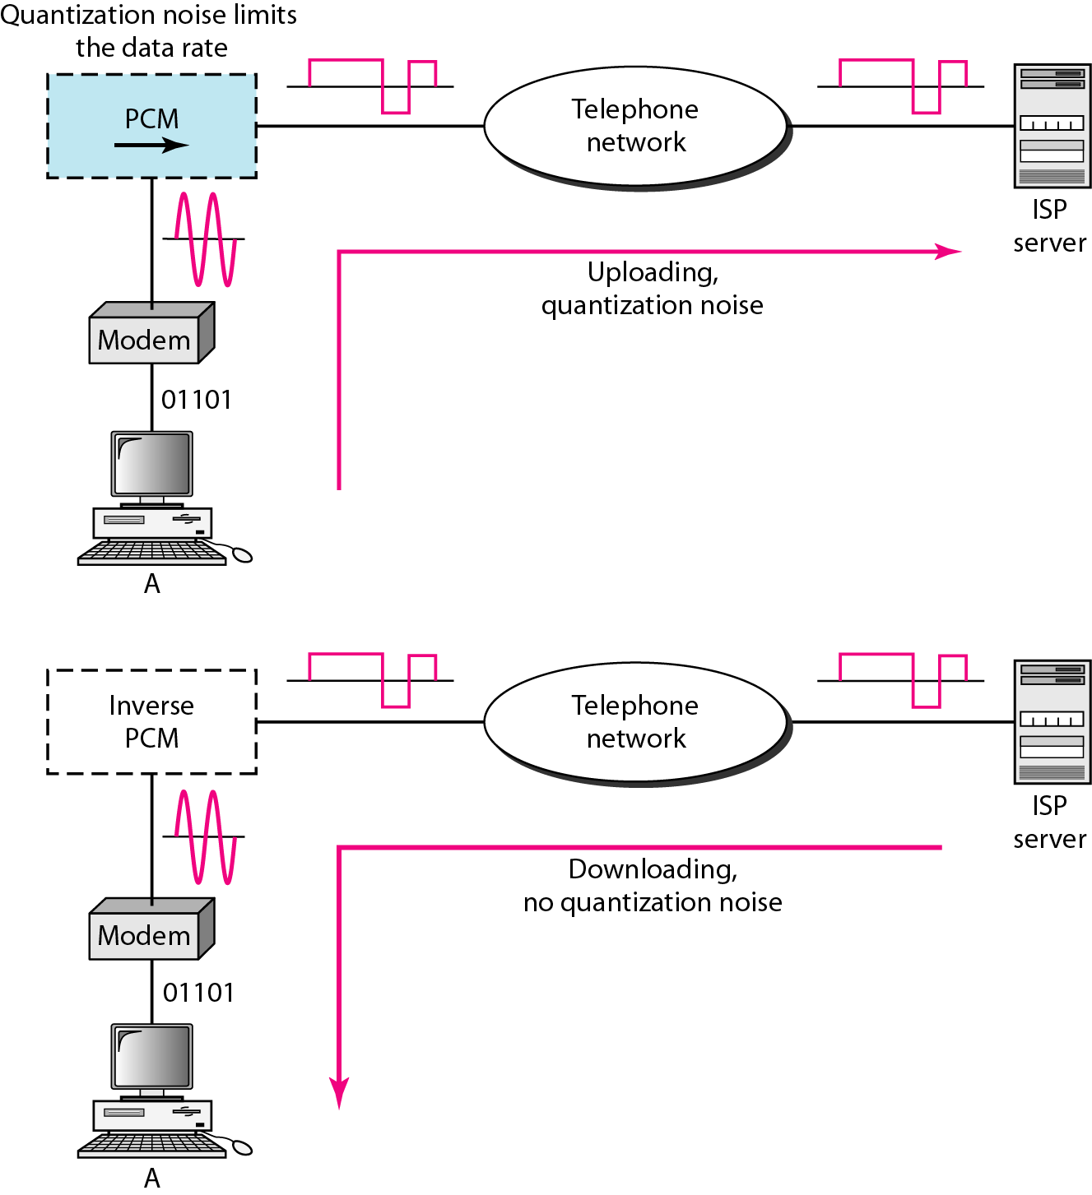
Figure 9.9 Uploading and downloading in 56K modems
NDSLab Copyright@2008

Slide 20
9-3 DIGITAL SUBSCRIBER LINE
After traditional modems reached their peak data rate, telephone companies developed another technology, DSL, to provide higher-speed access to the Internet. Digital subscriber line (DSL) technology is one of the most promising for supporting high-speed digital communication over the existing local loops.
Topics discussed in this section:
ADSL
ADSL Lite
HDSL
SDSL
VDSL
NDSLab Copyright@2008

Slide 21
Note
ADSL is an asymmetric communication technology designed for residential users; it is not suitable for businesses.
NDSLab Copyright@2008

Slide 22
Note
The existing local loops can handle bandwidths up to 1.1 MHz.
NDSLab Copyright@2008

Slide 23
Note
ADSL is an adaptive technology.
The system uses a data rate
based on the condition of
the local loop line.
NDSLab Copyright@2008

Slide 24
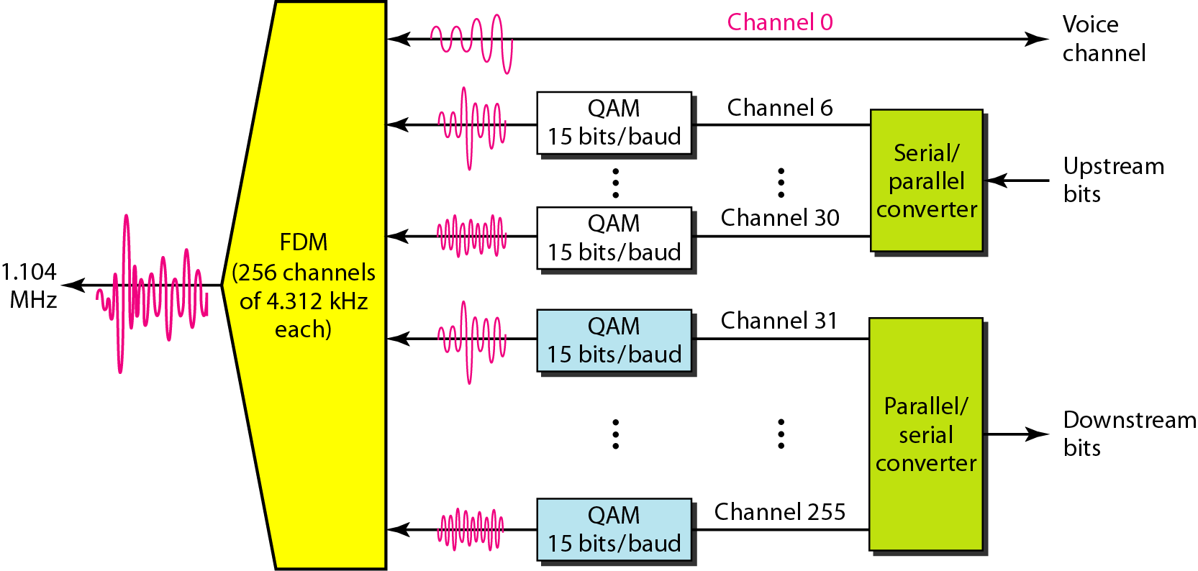
Figure 9.10 Discrete multitone technique (DMT)
NDSLab Copyright@2008

Slide 25
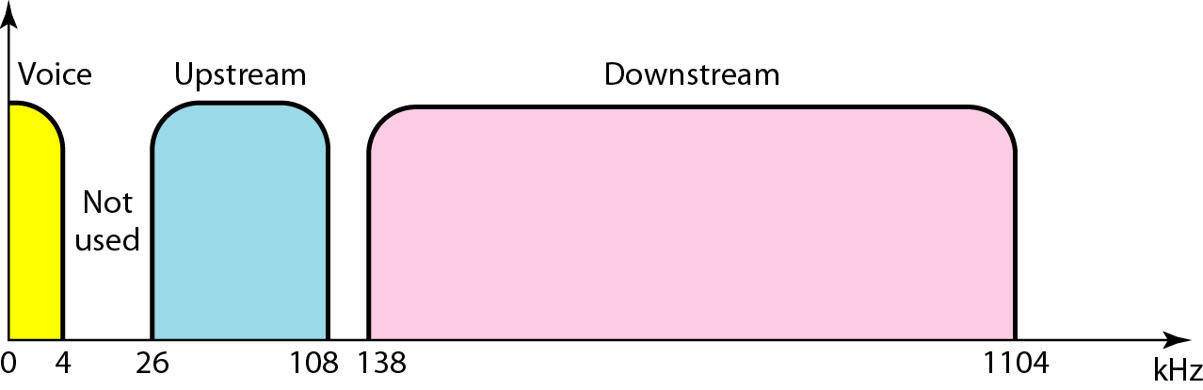
Figure 9.11 Bandwidth division in ADSL
NDSLab Copyright@2008

Slide 26
ADSL
Discrete multitone technique (DMT)
  Voice: Channel 0
  Idle: Channels 1-5 not used and provide a gap between voice and data
  Data: Channels 26-108 and 138-1104
Upstream data and control (4kHz/channel)
  Channels 6 to 30 (25 channels) are used for upstream
  One channel is for control, and 24 channels are for data transfer
  Bandwidth: 24x4000x15 = 1.44 Mbps
Downstream data and control
  Channels 31 to 255 (225 channels)
  One channel is for control, and 224 channels are for data transfer
  Bandwidth: 224x4000x15 = 13.4 Mbps
NDSLab Copyright@2008

Slide 27
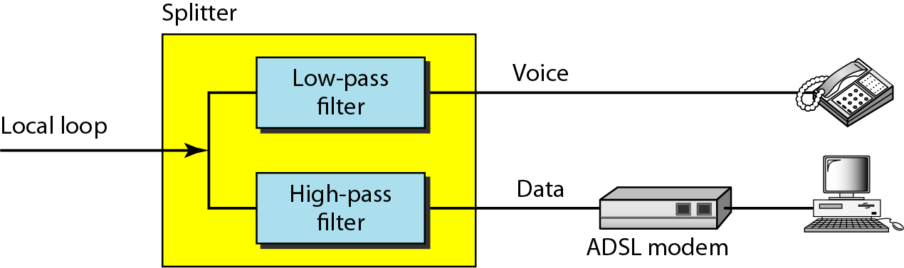
Figure 9.12 ADSL modem
NDSLab Copyright@2008

Slide 28
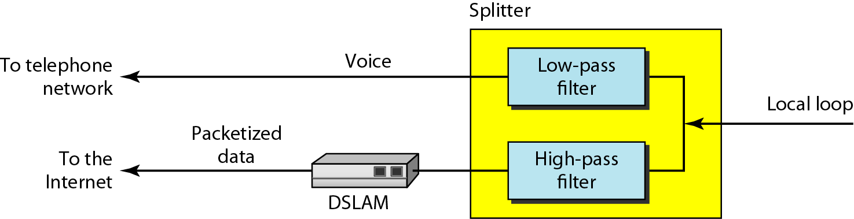
Figure 9.13 DSLAM
NDSLab Copyright@2008

Slide 29
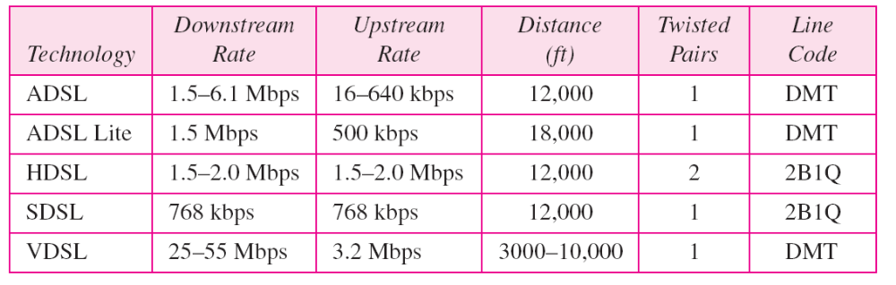
Table 9.2 Summary of DSL technologies
NDSLab Copyright@2008

Slide 30
9-4 CABLE TV NETWORKS
The cable TV network started as a video service provider, but it has moved to the business of Internet access. In this section, we discuss cable TV networks per se; in Section 9.5 we discuss how this network can be used to provide high-speed access to the Internet.
Topics discussed in this section:
Traditional Cable Networks
Hybrid Fiber-Coaxial (HFC) Network
NDSLab Copyright@2008

Slide 31
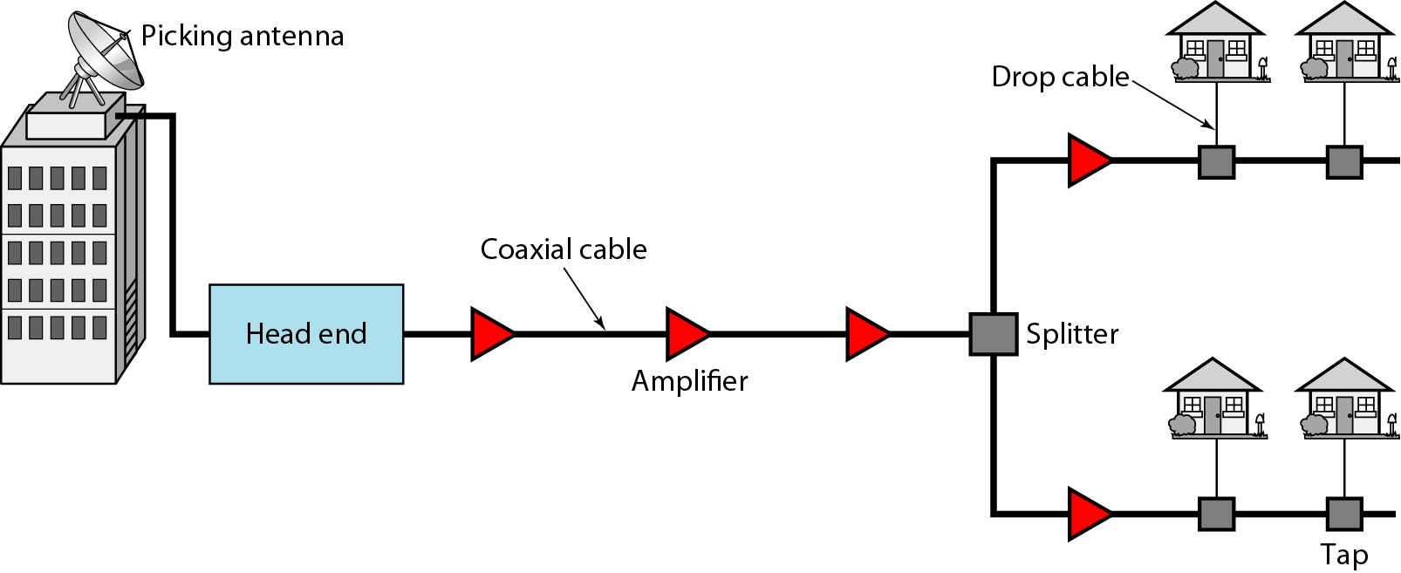
Figure 9.14 Traditional cable TV network
NDSLab Copyright@2008

Slide 32
Note
Communication in the traditional cable TV network is unidirectional.
NDSLab Copyright@2008

Slide 33
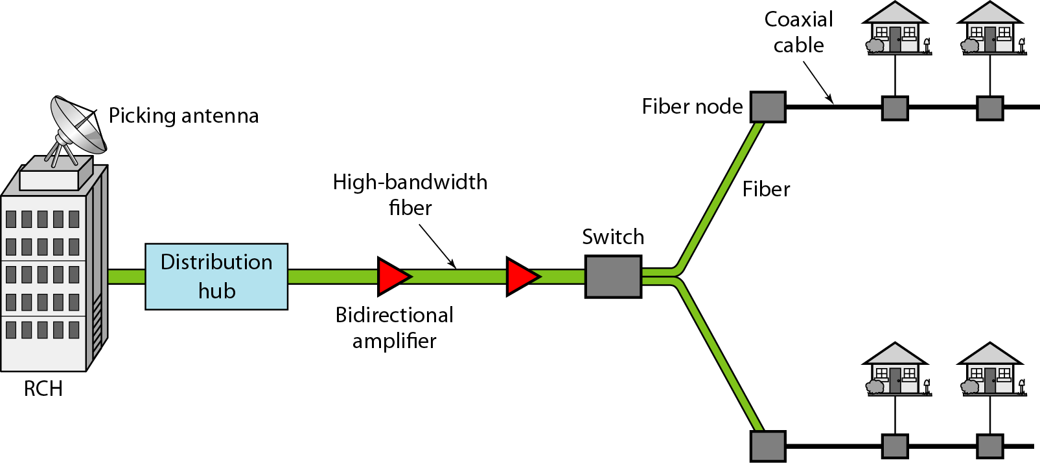
Figure 9.15 Hybrid fiber-coaxial (HFC) network
NDSLab Copyright@2008

Slide 34
Note
Communication in an HFC cable TV network can be bidirectional.
NDSLab Copyright@2008

Slide 35
9-5 CABLE TV FOR DATA TRANSFER
Cable companies are now competing with telephone companies for the residential customer who wants high-speed data transfer. In this section, we briefly discuss this technology.
Topics discussed in this section:
Bandwidth
Sharing
CM and CMTS
Data Transmission Schemes: DOCSIS
NDSLab Copyright@2008

Slide 36
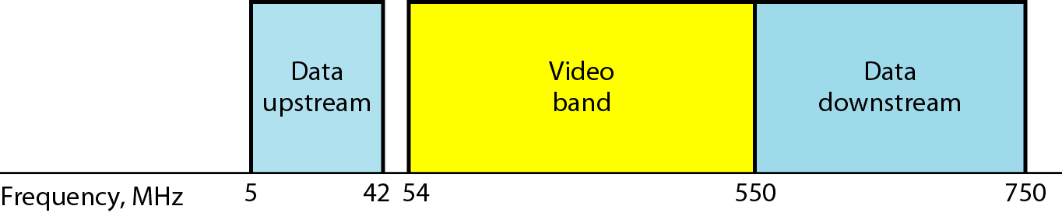
Figure 9.16 Division of coaxial cable band by CATV
NDSLab Copyright@2008

Slide 37
Note
Downstream data are modulated using the 64-QAM modulation technique.
NDSLab Copyright@2008

Slide 38
Note
The theoretical downstream data rate
is 30 Mbps.
NDSLab Copyright@2008

Slide 39
Note
Upstream data are modulated using the QPSK modulation technique.
NDSLab Copyright@2008

Slide 40
Note
The theoretical upstream data rate
is 12 Mbps.
NDSLab Copyright@2008

Slide 41
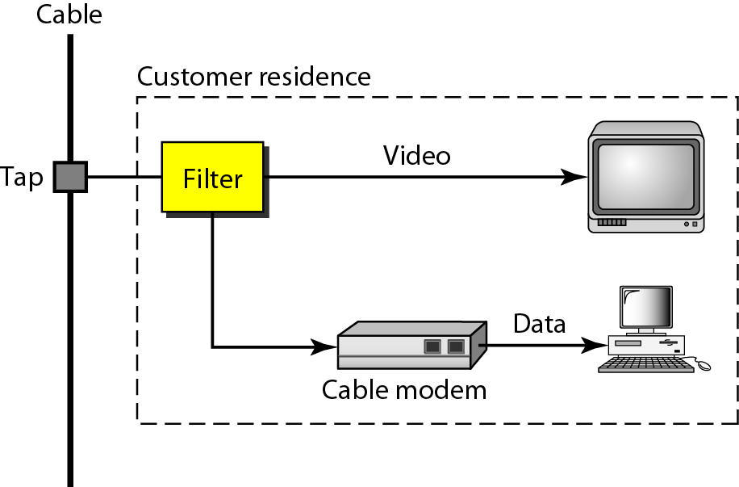
Figure 9.17 Cable modem (CM)
NDSLab Copyright@2008

Slide 42
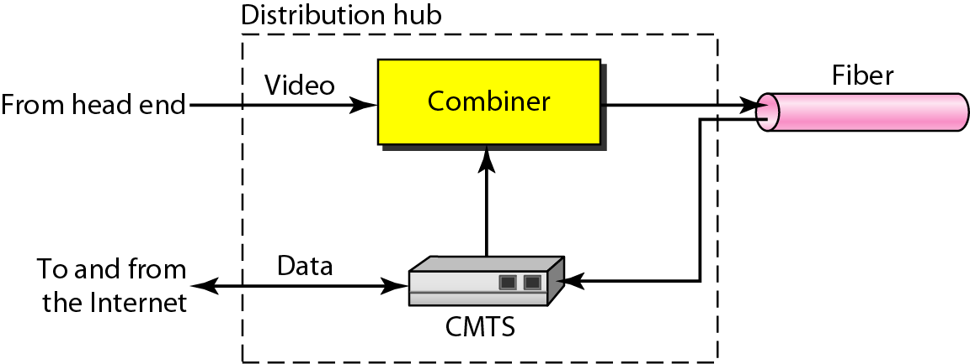
Figure 9.18 Cable modem transmission system (CMTS)
NDSLab Copyright@2008

